Slide 1

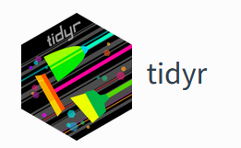
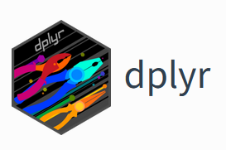
Coding club TEREC
17-06-2024

Slide 2
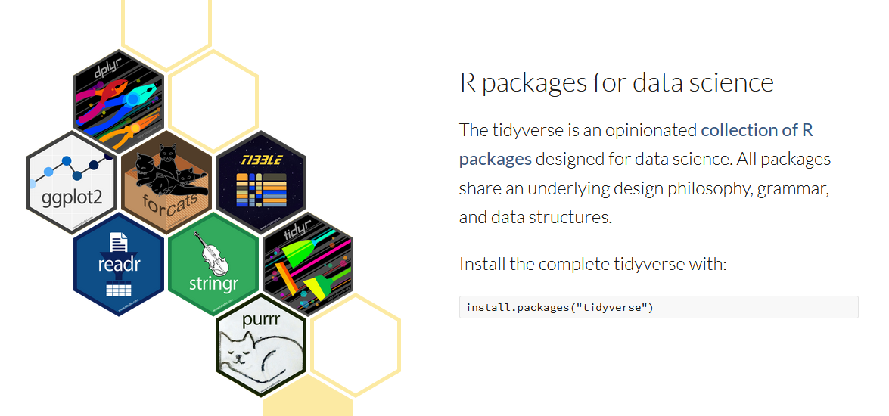
Tidyverse

Slide 3
Cheatsheets
https://rstudio.github.io/cheatsheets/html/tidyr.html
https://rstudio.github.io/cheatsheets/tidyr.pdf
https://rstudio.github.io/cheatsheets/html/data-transformation.html
https://rstudio.github.io/cheatsheets/data-transformation.pdf

Slide 4
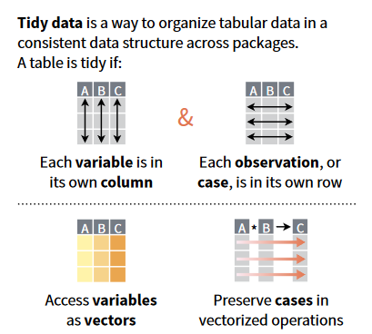
The goal of tidyr is to help you create tidy data. Tidy data is data where:
Each variable is a column; each column is a variable.
Each observation is a row; each row is an observation.
Each value is a cell; each cell is a single value.
→ Good basic to start analysing and plotting your data!
https://tidyr.tidyverse.org/

Slide 5
Loading data into R is often not the first step…
Even R-purists must admit some manual work is needed to clean up real-life datasets beforehand…
Clean and properly formatted data often happens before R
Personal taste when to switch to R
Best practices on data cleaning, e.g.
https://mammoth.io/blog/data-cleaning-in-excel/

Slide 6
dplyr is a grammar of data manipulation, providing a consistent set of verbs that help you solve the most common data manipulation challenges:
mutate()
select()
filter()
summarise()
arrange()
https://dplyr.tidyverse.org/
+group_by()

Slide 7
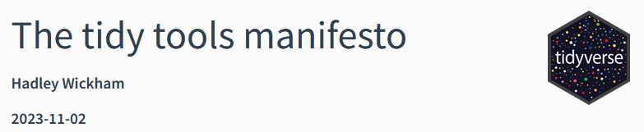
Tidyverse philosophy
Re-use existing data structures (tidy data)
Combine pieces of manipulations with ‘piping’: %>%
Embrace (don’t fight) functional programming (vs object-oriented languages such as Python)
Code should be readable: it’s meant to be read by other scientists (and future you), not only to be run in the background
https://tidyverse.tidyverse.org/articles/manifesto.html

Slide 8

Interactive session!
What would you like to learn?
During exercises: do you have a tip or trick you want to share?
Write it down on the coloured paper!

Slide 9

Exercises
Flow is with basic exercises
Even for the advanced dplyr’ers, refreshing basics is often valuable!
AND packages are living things: you might learn some new functions or short-cuts that were recently added to tidyr/dplyr that will make your life easier ;-)
For tidyr and dplyr, a harder exercise (that combines different aspects of the packages, without step-by-step run through) is added, so you can challenge yourself!
Last part: tips & tricks, the more interactive part!

Slide 10
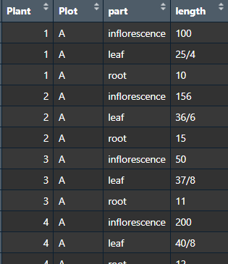
Exercises part 1: tidy data
How tidy or untidy is this dataset and how to solve it?

Slide 11
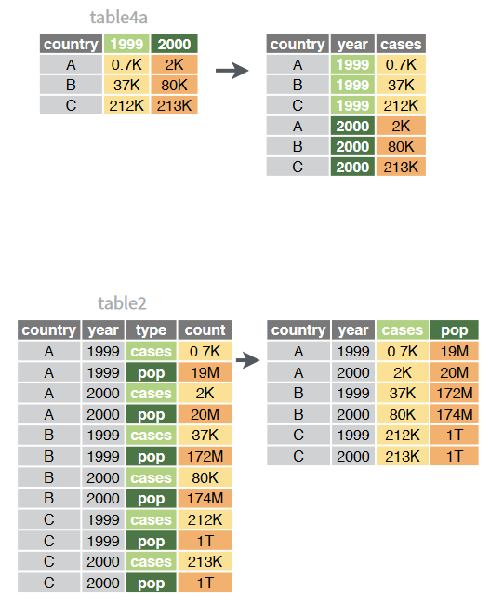
Exercises part 1: tidy data
One variable might be spread across multiple columns
One observation might be scattered across multiple rows
Typically, a dataset will only suffer from one of these problems (it’ll only suffer from both if you’re really unlucky). To fix these problems, you’ll need the two most important functions in tidyr: pivot_wider() and pivot_longer()

Slide 12
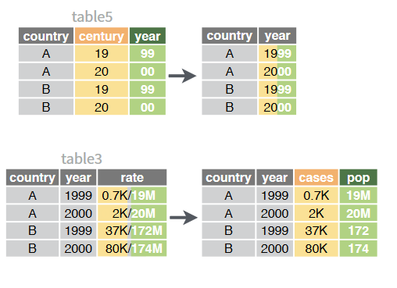
Exercises part 1: tidy data
Splitting or combining columns: separate() and unite()

Slide 13
Exercises part 2: dplyr – data manipulation
With the tidied dataset we will:
Calculate new variables
Select variables
Extract and arrange values
Make summaries
Extra: making summaries themselves tidy
Merge tables

Slide 14
Exercises part 3: Advanced tips & tricks
Piping a dataset directly into ggplot2 with %>%
Xx -> variable instead of variable <- xx
In a loop/function: variable_name, to be used in manipulation/ggplot: !!sym(variable_name)

